Slide 1
React - Session 2
Atul Khandelwal

Slide 2

Topics to be covered
Render Props
Higher Order Components (HOCs)
Hooks
Context Api
Routing
Error Boundaries

Slide 3
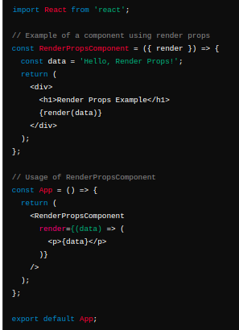
Render Props
Render props allows components to share code and logic
A component with a render prop takes a function that returns a React element and calls it instead of implementing its own render logic
It promotes reusability, flexibility, and separation of concerns

Slide 4
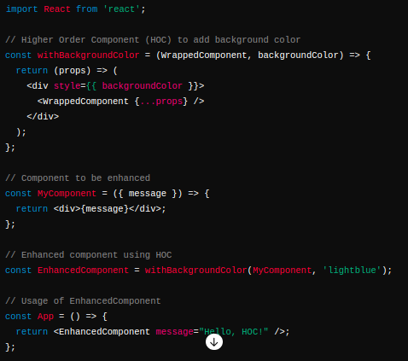
Higher Order Components
A higher-order component is a function that takes a component and returns a new component
HOCs do not modify the original component; instead, they wrap it with additional capabilities

Slide 5
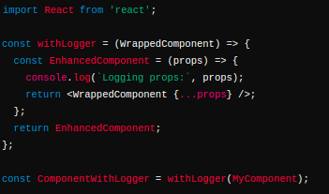
Benefits of HOC
Ensure that props are passed correctly between components
HOCs create new component identities, which can affect certain React features like Hooks.
Naming Convention
Prefixing with “with-”
CamelCase Naming
Descriptive Naming
Ex. withLogger
A higher-order component is a function that takes a component and returns a new component
HOCs do not modify the original component; instead, they wrap it with additional capabilities
Benefits
Consideration

Slide 6
Hooks
Hooks allow function components to have access to state and other React features.
They were introduced in React 16.8
Hooks provide stateful logic and side effects (like lifecycle methods) without writing a class component.
Hooks Rules
Hooks can only be called inside React function components.
Hooks can only be called at the top level of a component.
Hooks cannot be conditional
Typically named with prefix “use” and should be camelCase
Ex. useState, useEffect etc.

Slide 7
Some of Basic Hooks
useState
useEffect
useRef
useMemo
useCallback

Slide 8
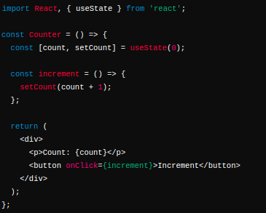
useState Hook
useState hook allows functional components to manage local state. It returns a stateful value and a function to update it.
It's one of the most commonly used hooks and is essential for maintaining stateful logic within functional components.

Slide 9
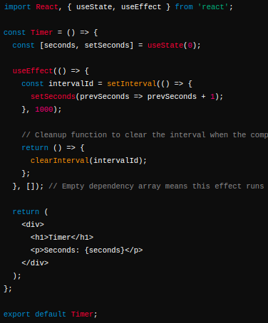
useEffect Hook
React useEffect hook handles the effects of the dependency array.
It allows us to perform side effects like fetching data, dom updation, timers etc on the components.
It is called every time any state if the dependency array is modified or updated

Slide 10
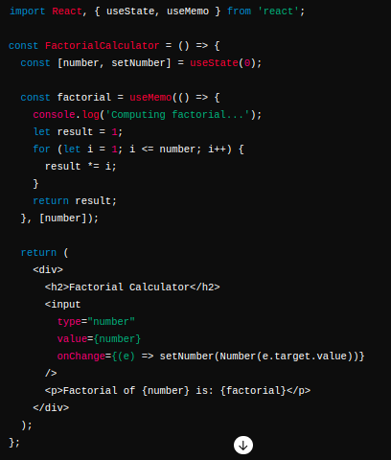
useMemo Hook
The React useMemo Hook returns a memoized value.
The useMemo Hook only runs when one of its dependencies update.
This can improve performance.

Slide 11
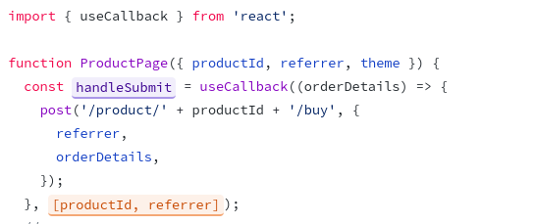
useCallback Hook
React useCallback hook returns a memoized function to reduce unnecessary callbacks.
The useCallback Hook only runs when one of its dependencies update.
This can also improve performance by reducing unnecessary rendering.

Slide 12
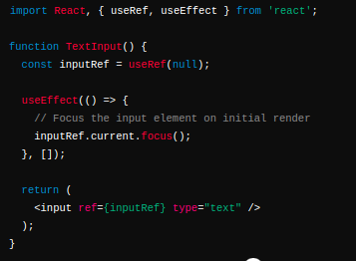
useRef Hook
The useRef hook is useful for accessing DOM elements or keeping any mutable value that persists between renders
It returns a mutable ref object whose .current property is initialized to the passed argument (initialValue)

Slide 13
Context Api
The Context API provides a way to pass data through the component tree without having to pass props manually at every level.
It's designed to share data that can be considered "global" for a tree of React components.
It's particularly useful for global data like themes, user authentication, or language preferences.
Avoids prop drilling by passing data through the component tree.

Slide 14
How Context Api Works
Creating a Context
We need to create a context object using React.createContext(). This function returns an object with Provider and Consumer components.
Provider Component
The Provider component is used to wrap the part of the component tree where you want to make the context available.
It accepts a value prop which can be any JavaScript value (object, array, function, etc.) that you want to share.
Consuming Context
To access the context within a component that is a descendant of the Provider, use the Consumer component or the useContext hook
Using Consumer:
Using useContext Hook

Slide 15
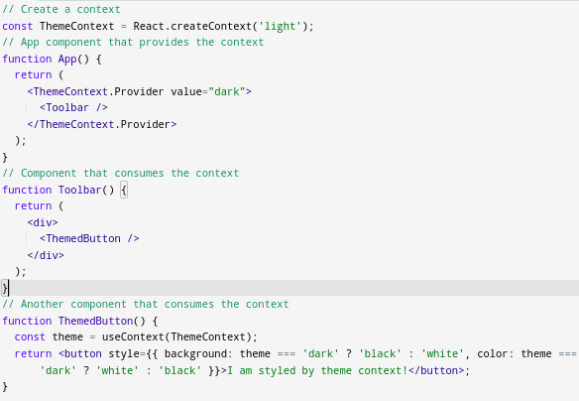
Example

Slide 16
React Routing
React Routing refers to the process of managing navigation and rendering different components based on the URL in a React application.
It allows us to create single-page applications (SPAs) where the content changes dynamically without the need for full page reloads.
React Router is the most popular library used for routing in React applications.
To install React Router in our application using below command

Slide 17
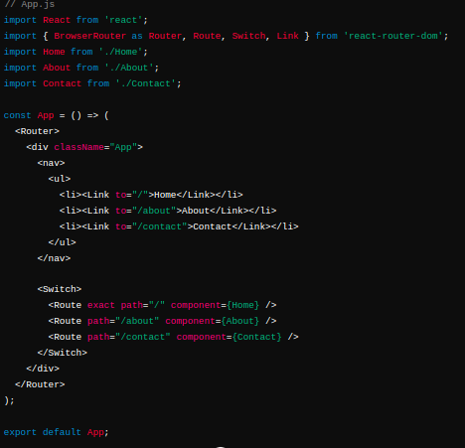
Example - React Routing

Slide 18
Error Boundaries
Error boundaries are React components that catch JavaScript errors anywhere in their child component tree, log those errors, and display a fallback UI instead of crashing the entire application.
It helps developers to handle errors gracefully and improve the overall stability of React applications.
Only class components can be error boundaries
Error boundaries only catch errors in the components below them in the tree.
An error boundary can't catch an error within itself.

Slide 19
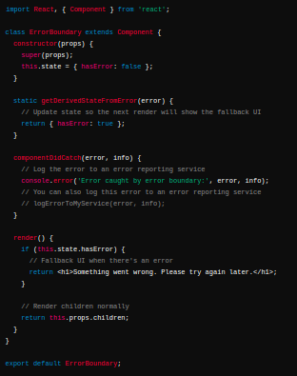
Error Boundaries Component

Slide 20
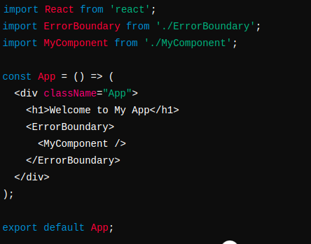
Example
Once we have defined an error boundary component, we can wrap it around any part of our application where we want to handle errors:

Slide 21
THANK YOU

